Slide 1

Caravan Insurance Customer Identification
Jiahui Bi
Prof. Mahmoud Daneshmand
MIS637 Knowledge Discovery Databases

Slide 2
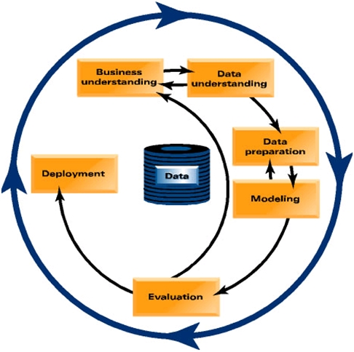
CROSS-INDUSTRY STANDARD PROCESS (CRISP–DM)
Business understanding phase.
Data understanding phase
Data preparation phase
Modeling phase
Evaluation phase
Deployment phase

Slide 3
CONTENTS
01
BUSINESS UNDERSTANDING
02
DATA UNDERSTANDING
03
DATA PREPARATION
04
MODELING
05
EVALUATION
06
DEVELOPMENT

Slide 4

1
BUSINESS UNDERSTANDING
St
DATA UNDERSTANDING
DATA PREPARATION
MODELING
EVALUATION
DEPLOYMENT

Slide 5



BUSINESS UNDERSTANDING
“Can you predict who would be interested in buying a caravan insurance policy and give an explanation why?”
Predict which customers are potentially interested in a caravan insurance policy. Find the subset of customers with a probability of having a caravan insurance policy above some boundary probability.
Describe the actual or potential customers; give a clear insight to why customers have a caravan insurance policy and how these customers are different from other customers.

Slide 6

2
BUSINESS UNDERSTANDING
nd
DATA UNDERSTANDING
DATA PREPARATION
MODELING
EVALUATION
DEPLOYMENT

Slide 7
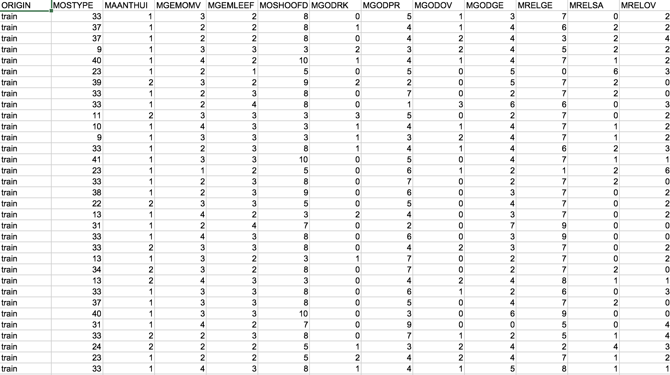
RAW DATA

Slide 8
DATA UNDERSTANDING
quantity
Eg: the number of cars
value | number | value | number
1 | 1 | 4 | 4
2 | 2 | 5 | 5
3 | 3 | 6 | 6
age range
Eg: the average of age
value | Age range | value | Age range
1 | 20-30 | 4 | 50-60
2 | 30-40 | 5 | 60-70
3 | 40-50 | 6 | 70-80
9822 rows
Training data: 5822 rows
Evaluation data: 4000 rows
85 features
4 types
percentage
Eg: married
value | corresponding percentage | value | corresponding percentage
0 | 0% | 5 | 50-62%
1 | 1-10% | 6 | 63-75%
2 | 11-23% | 7 | 76-88%
3 | 24-36% | 8 | 89-99%
4 | 37-49% | 9 | 100%
total number
Eg: Contribution private third party insurance
value | Corresponding amount | value | Corresponding amount
0 | 0 | 5 | 500-999
1 | 1-49 | 6 | 1000-4999
2 | 50-99 | 7 | 5000-9999
3 | 100-199 | 8 | 10000-19999
4 | 200-499 | 9 | 20000+

Slide 9

3
BUSINESS UNDERSTSNDING
DATA UNDERSTANDING
DATA PREPARATION
rd
MODELING
EVALUATION
DEPLOYMENT

Slide 10
DATA PREPARATION
1
PERVENTAGE LEVEL OF HIGH LEVEL EDUCATION
NUMBER OF HOUSE
2
EXPLORATORY
DATA ANALYSIS
This dataset is total clear. So we just jump to EDA.
3
AVERAGE AGE LEVEL
4
AVERAGE INCOME LEVEL

Slide 11
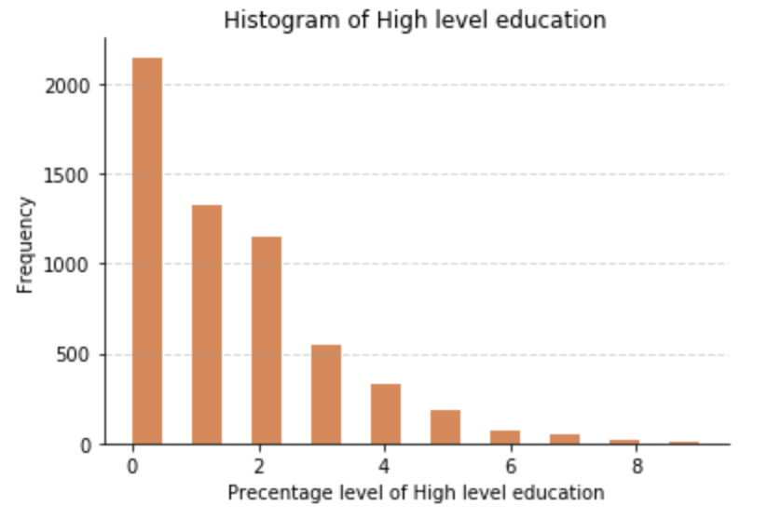
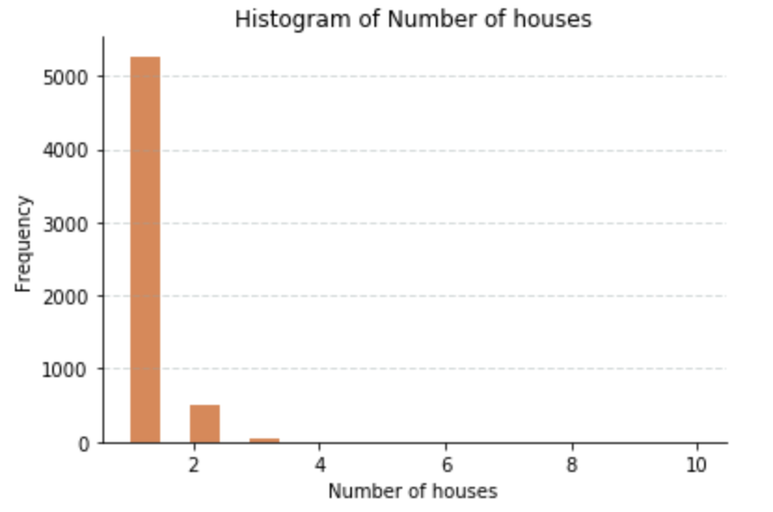
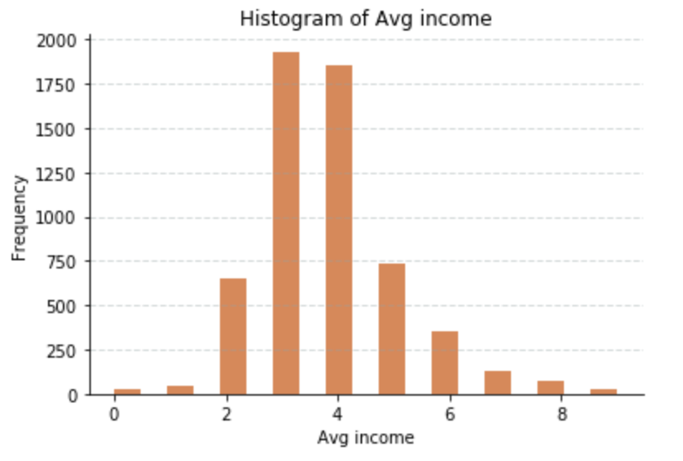
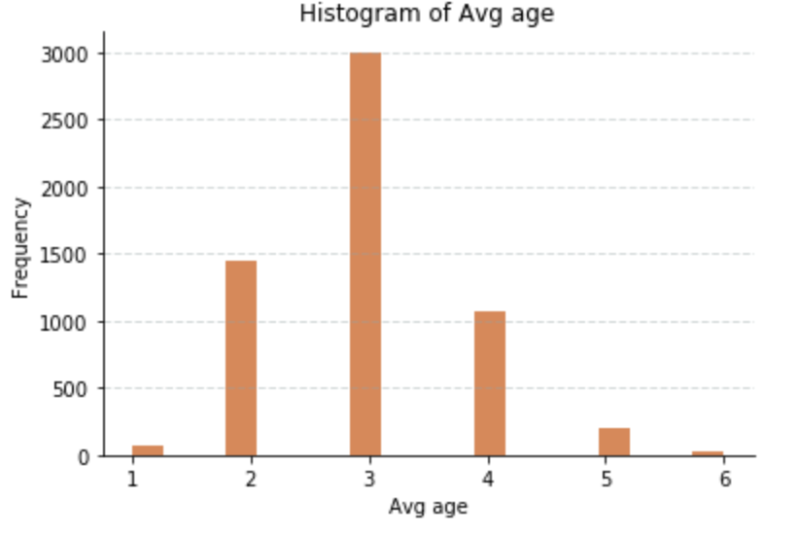

EXPLORATORY DATA ANALYSIS
High level education concentrate on 2-, which means the high level education percentages are 20%-
Most clients have only 1 house property.
The main value of average age is 3, which represents 40-50 years old.
The average income distribution approximatively forms normal distribution.

Slide 12
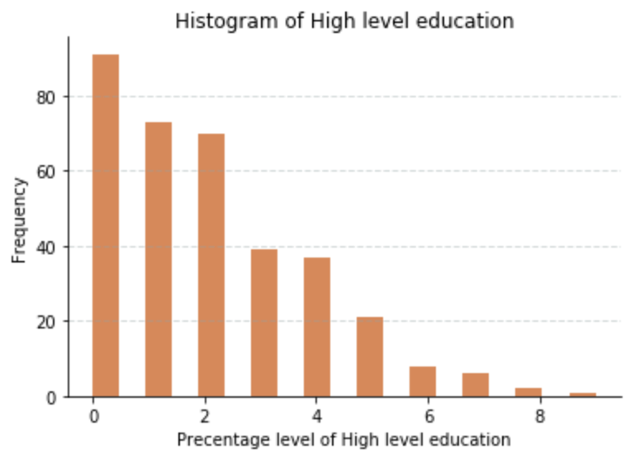
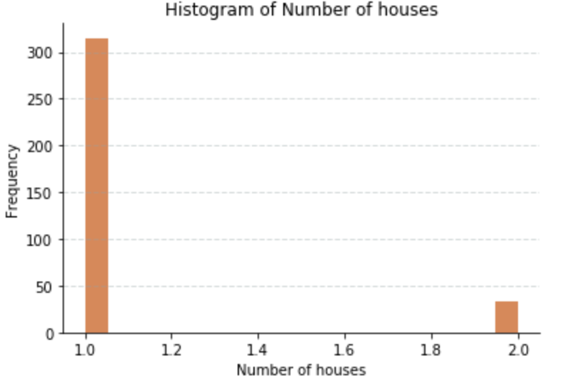
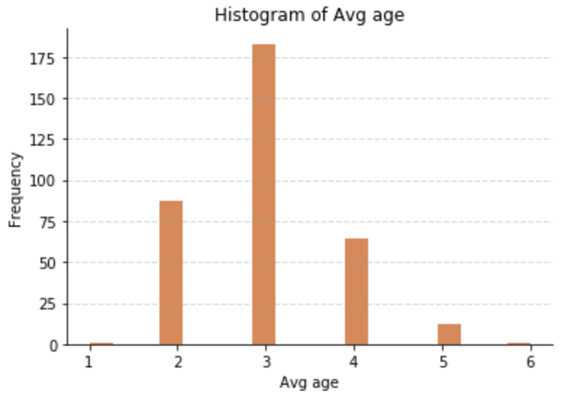
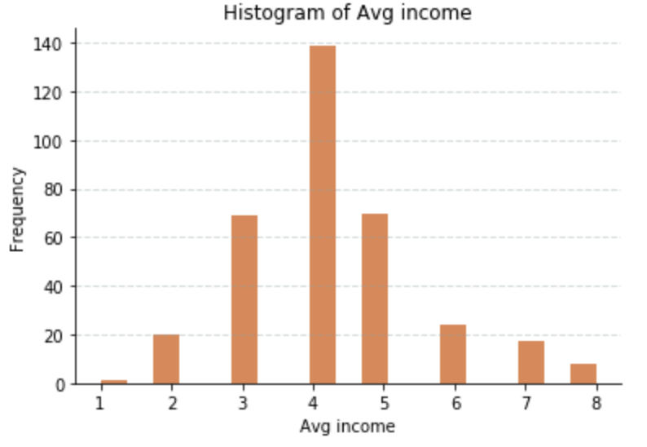
EXPLORATORY DATA ANALYSIS
High level education crowd tends to buy caravan insurance.
Most clients have only 1 house property.
Major purchasing crowd is also around 40-50 years old.
The average income distribution doesn’t change much.

Slide 13

4
BUSINESS UNDERSTANDING
DATA UNDERSTANDING
DATA PREPARATION
th
MODELING
EVALUATION
DEPLOYMENT

Slide 14
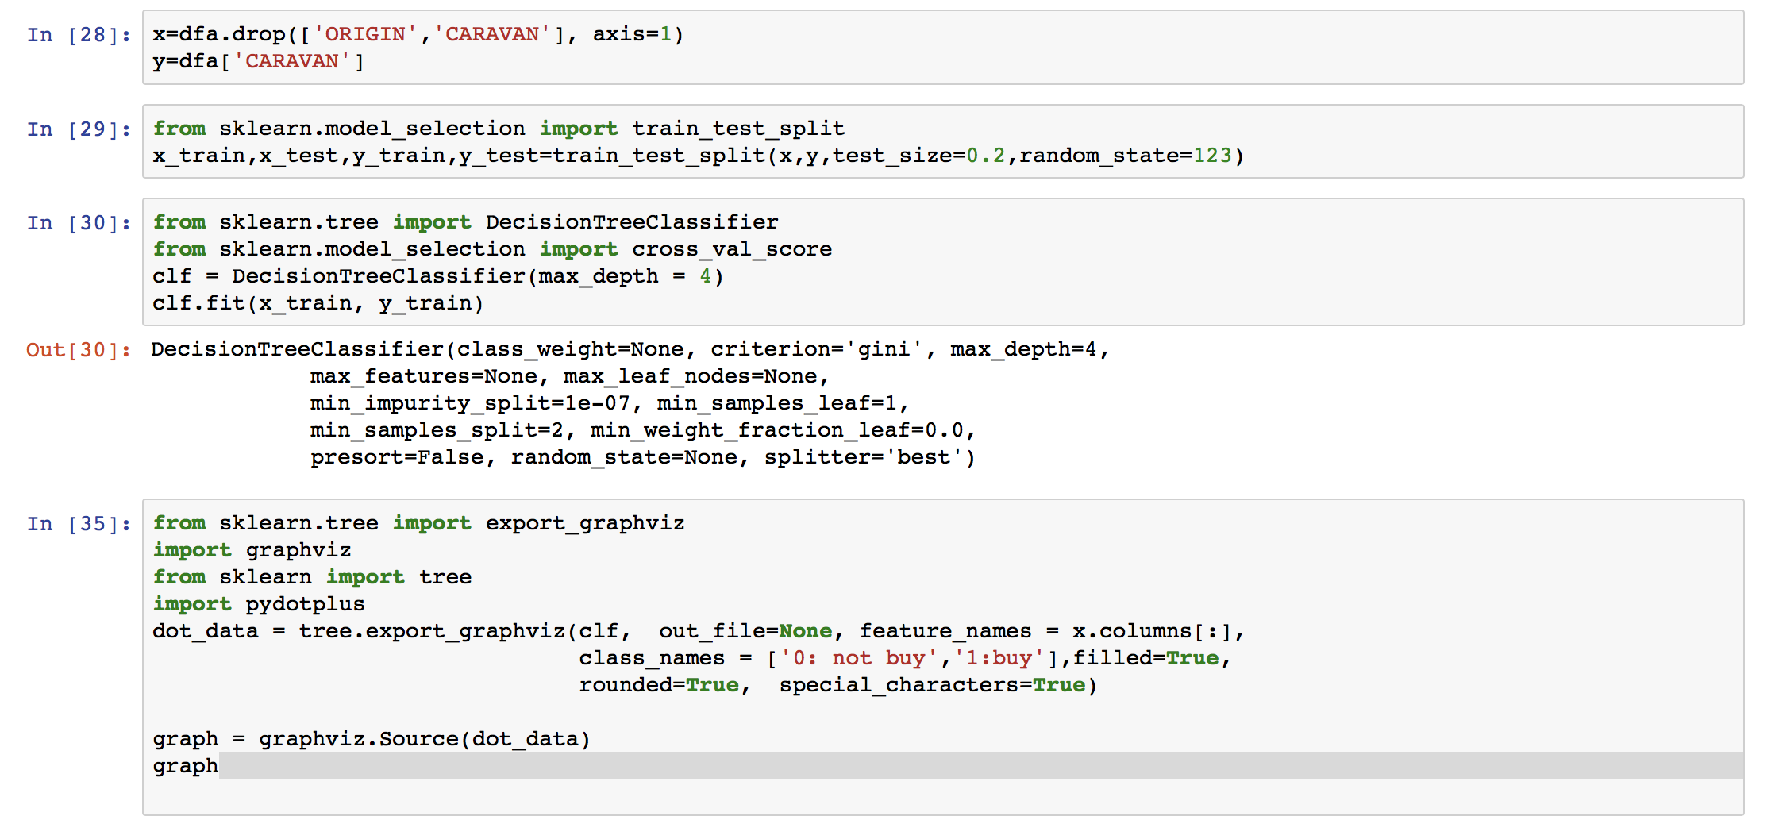
MODELING
Decision Trees (DTs) are a non-parametric supervised learning method used for classification and regression. The goal is to create a model that predicts the value of a target variable by learning simple decision rules inferred from the data features.
Scilit-learn decision trees

Slide 15
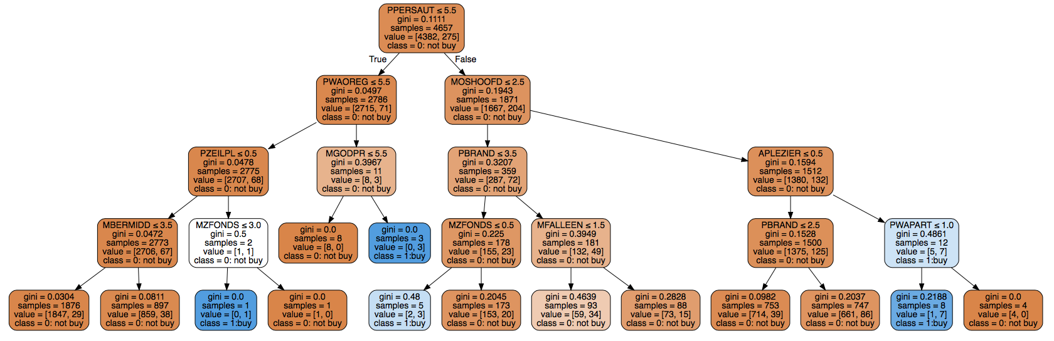
MODELING

Slide 16
5
BUSINESS UNDERSTANDING
DATA UNDERSTANDING
DATA PREPARATION
th
MODELING
EVALUATION
DEPLOYMENT

Slide 17
EVALUATION
We explored the data by splitting it (using select nodes) into non-caravan insurance records and caravan insurance records. Using the statistics node we identified a 4658 to 1164 split. This represents a clear under sample of caravan insurance holders.
0.943
0.936
TRAIN DATA
TEST DATA

Slide 18
EVALUATION
We test our model by the evaluation dataset, and get 93.7% accurancy.
93.7%
EVALUATION DATA

Slide 19
6
BUSINESS UNDERSTANDING
DATA UNDERSTANDING
DATA PREPARATION
th
MODELING
EVALUATION
DEPLOYMENT

Slide 20
DEPLOYMENT
Client Information
Results
Buyer personas
precision marketing
Modeling

Slide 21
CONCLUSION
According to the decision tree, the number of cars is important and another important feature is the disability insurance policies which makes sense.
Evaluation dataset accuracy: 93.7%
Precision Marketing:
Send promotion email to the potential customers
This dataset can help us do other insurance analysis.

Slide 22
REFERENCE
Blake, C., & Merz, C. (1998). UCI Repository of machine learning databases.
Breiman, L. (1996). Bias, variance, and arcing classifiers. Technical Report, Statistics Department, University of California.
Chapman, P., Clinton, J., Khabaza, T., Reinartz, T., & Wirth, R. (1999). The CRISP-DM process model. Technical Report, Crisp Consortium. http://www.crisp-dm.org/.

Slide 23


THANKS

